Slide 1
Examples of Plagiarism
Adapted from Azman and Fox (2013)

Slide 2
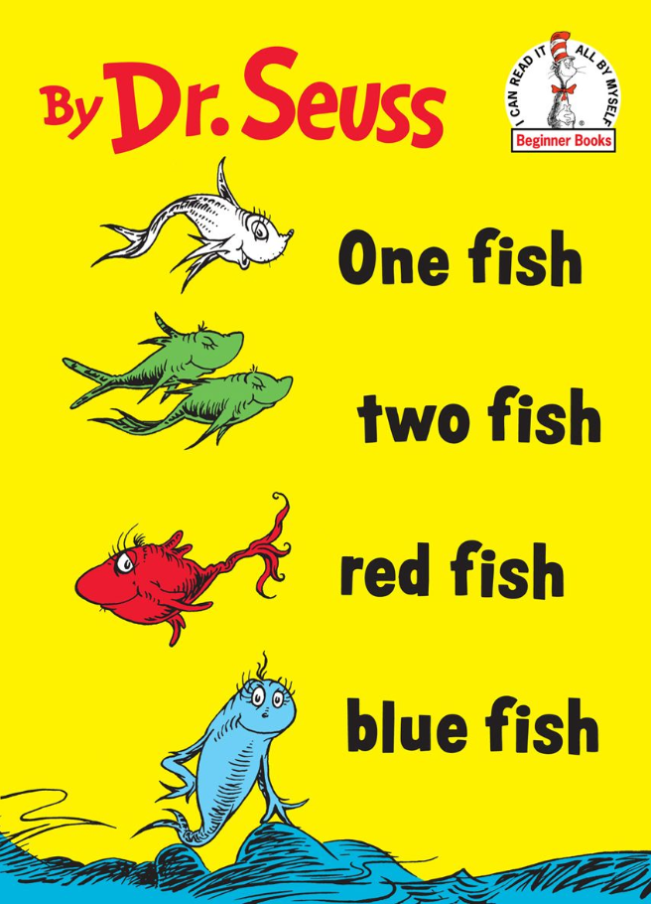
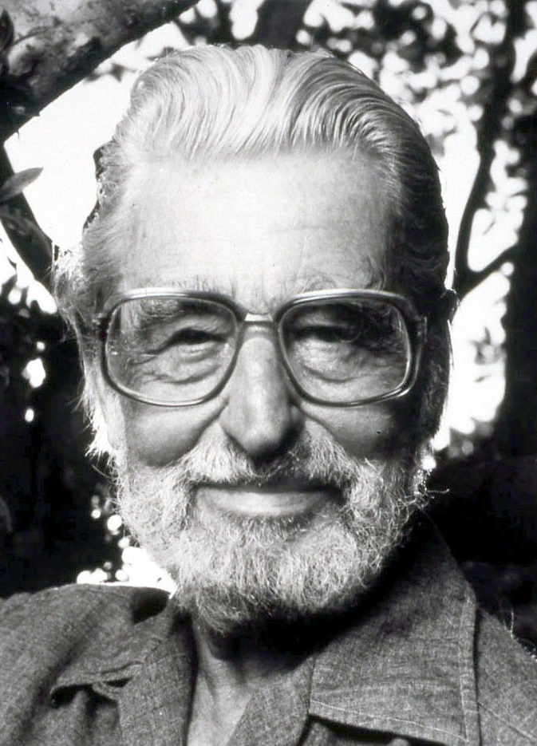
All related images: https://www.amazon.com/One-Fish-Blue-Beginner-Books-ebook/dp/B00ESF274U
Theodore Seuss Geisel
Image: http://www.playbill.com/person/theodor-seuss-geisel-vault-0000116084

Slide 3
Imagine you are writing a paper about fish biology
…and one of your sources is One Fish Two Fish Red Fish Blue Fish.

Slide 4
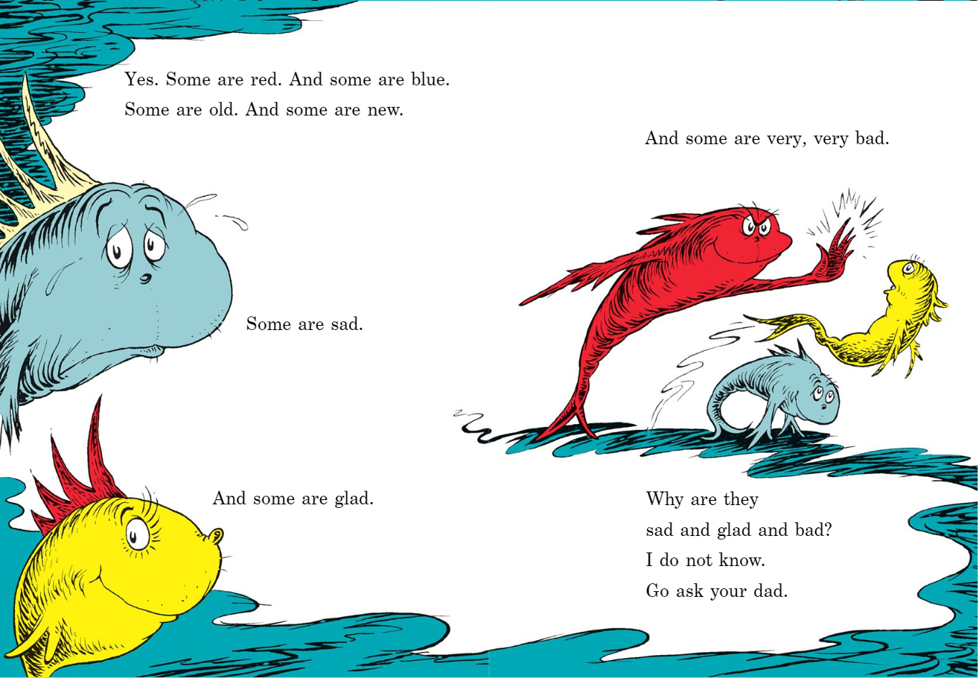

Slide 5
Writing Example #1:
There are many different types of fish in the ocean. Some are red. And some are blue. Some are old. And some are new. We don’t know exactly how many fish there are, but it is numerous.
Is this plagiarism?

Slide 6
Writing Example #1:
There are many different types of fish in the ocean. Some are red. And some are blue. Some are old. And some are new. We don’t know exactly how many fish there are, but it is numerous.
Yes. This is plagiarism.
It uses someone else’s ideas WITHOUT citing them.
Note: this is quoting. You must use quotation and properly cite and reference your resources.

Slide 7
Writing Example #1:
There are many different types of fish in the ocean. Some are red. And some are blue. Some are old. And some are new. We don’t know exactly how many fish there are, but it is numerous.
Corrected:
There are many different types of fish in the ocean. As Seuss (1988) asserts, “Some [fish] are red. And some are blue. Some are old. And some are new.” (p. 4) We don’t know exactly how many fish there are, but it is numerous.
***Book information will need to be properly listed in the References section of the assignment.

Slide 8
Writing Example #2:
There are many different types of fish in the ocean: red, blue, old, and new. We don’t know exactly how many fish there are, but it is numerous.
Is this plagiarism?

Slide 9
Writing Example #2:
There are many different types of fish in the ocean: red, blue, old, and new. We don’t know exactly how many fish there are, but it is numerous.
Yes. This is plagiarism.
It uses someone else’s ideas WITHOUT citing them.
Note: this is paraphrasing or summarizing. You must properly cite and reference your resources.

Slide 10
Writing Example #2:
There are many different types of fish in the ocean: red, blue, old, and new. We don’t know exactly how many fish there are, but it is numerous.
Corrected:
There are many different types of fish in the ocean: red, blue, old, and new (Seuss, 1988, p. 4). We don’t know exactly how many fish there are, but it is numerous.
***Book information will need to be properly listed in the References section of the assignment.

Slide 11
Writing Example #3:
There are many different types of fish in the ocean with varying colours, life spans, and temperaments. We don’t know exactly how many fish there are, but it is numerous.
Is this plagiarism?

Slide 12
Writing Example #3:
There are many different types of fish in the ocean with varying colours, life spans, and temperaments. We don’t know exactly how many fish there are, but it is numerous.
Yes. This is plagiarism.
It uses someone else’s ideas WITHOUT citing them.
Note: this is paraphrasing or summarizing. You must properly cite and reference your resources.

Slide 13
Writing Example #3:
There are many different types of fish in the ocean with varying colours, life spans, and temperaments. We don’t know exactly how many fish there are, but it is numerous.
Corrected:
There are many different types of fish in the ocean with varying colours, life spans, and temperaments (Seuss, 1988, pp. 4-5). We don’t know exactly how many fish there are, but it is numerous.
***Book information will need to be properly listed in the References section of the assignment.

Slide 14
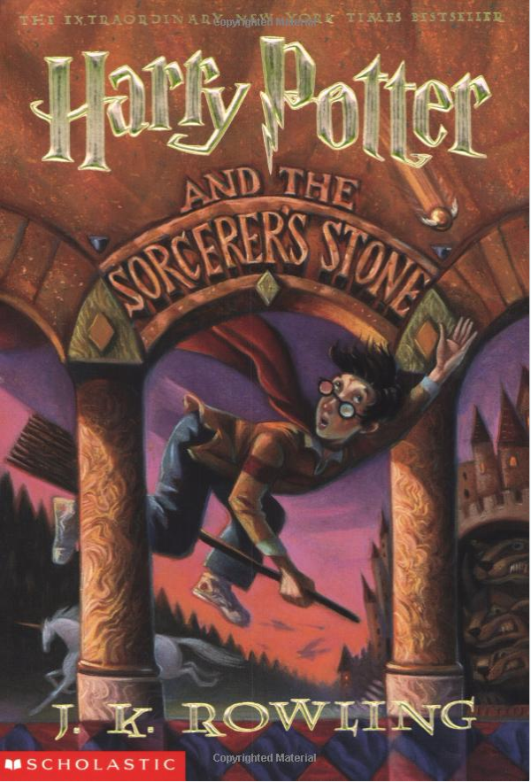
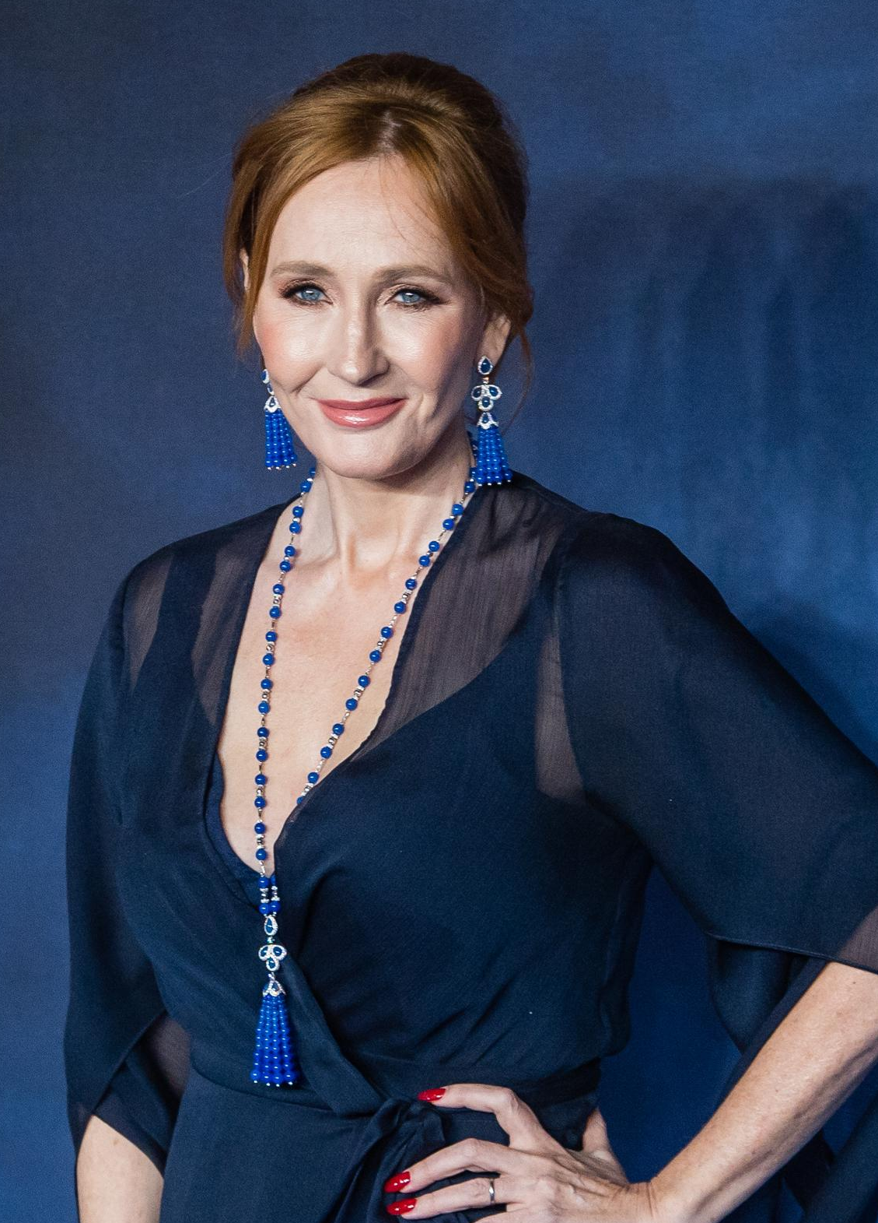
All related images: https://www.amazon.com/Harry-Potter-Sorcerers-Stone-Rowling/dp/059035342X
JK Rowling
Image: https://www.forbes.com/profile/jk-rowling/

Slide 15
Imagine you are writing a paper about family dynamics
…and one of your sources is Harry Potter and the Sorcerer’s Stone.

Slide 16
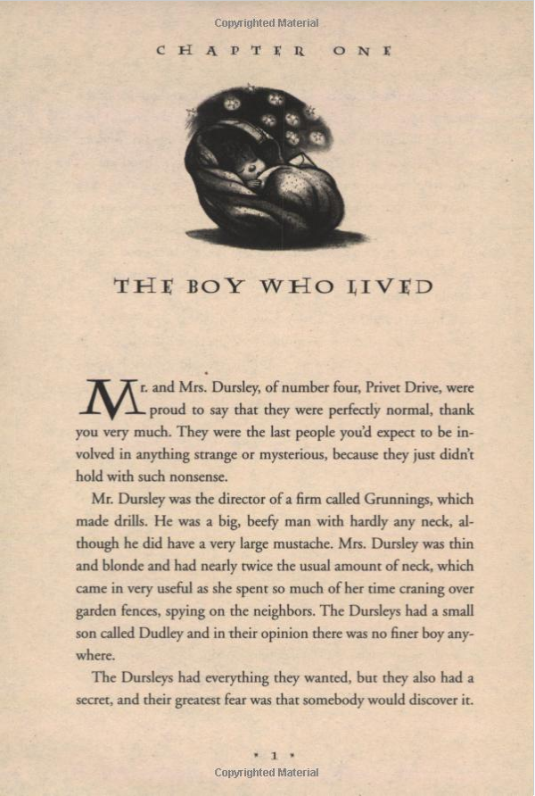
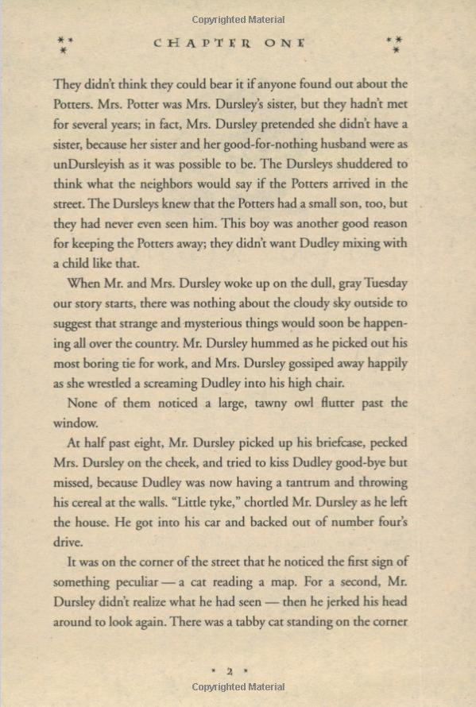

Slide 17
Writing Example #4:
The relationship between Mr. and Mrs. Dursley and Potters was strained. “Mrs. Potter was Mrs. Dursley’s sister, but they hadn’t met for several years” on account of Mrs. Dursely’s belief that her sister and her husband were good-for-nothing.
Is this plagiarism?

Slide 18
Writing Example #4:
The relationship between Mr. and Mrs. Dursley and Potters was strained. “Mrs. Potter was Mrs. Dursley’s sister, but they hadn’t met for several years” on account of Mrs. Dursely’s belief that her sister and her husband were good-for-nothing.
Yes. This is plagiarism.
It uses someone else’s ideas WITHOUT citing them.
It contains quotation marks for the quote, but no citation nor reference.

Slide 19
Writing Example #4:
The relationship between Mr. and Mrs. Dursley and Potters was strained. “Mrs. Potter was Mrs. Dursley’s sister, but they hadn’t met for several years” on account of Mrs. Dursely’s belief that her sister and her husband were good-for-nothing.
Corrected:
The relationship between Mr. and Mrs. Dursley and Potters was strained. “Mrs. Potter was Mrs. Dursley’s sister, but they hadn’t met for several years” on account of their belief that her sister and her husband were good-for-nothings (Rowling, 1998, p. 2).

Slide 20
Writing Example #5:
The relationship between Mr. and Mrs. Dursley and Potters is strained. Mrs. Potter is Mrs. Dursley’s sister, but they haven’t reunited for many years on account of their belief that her sister and her husband were good-for-nothings.
Is this plagiarism?

Slide 21
Writing Example #5:
The relationship between Mr. and Mrs. Dursley and Potters is strained. Mrs. Potter is Mrs. Dursley’s sister, but they haven’t reunited for many years on account of their belief that her sister and her husband were good-for-nothings.
Yes. This is plagiarism.
This is patchwork (replacing words).
It uses someone else’s ideas WITHOUT citing them.
You must properly cite and reference your resources.

Slide 22
Writing Example #5:
The relationship between Mr. and Mrs. Dursley and Potters is strained. Mrs. Potter is Mrs. Dursley’s sister, but they haven’t reunited for many years on account of their belief that her sister and her husband were good-for-nothings.
Corrected:
The relationship between Mr. and Mrs. Dursley and Potters is strained. Mrs. Potter is Mrs. Dursley’s sister, but they haven’t reunited for many years on account of their belief that her sister and her husband were good-for-nothings (Rowling, 1998, p. 2).

Slide 23
Writing Example #6:
The relationship between Mr. and Mrs. Dursley and Potters was strained. Mrs. Potter was Mrs. Dursley’s sister, but they hadn’t met for several years on account of their belief that her sister and her husband were good-for-nothings (Harry Potter and the Sorcerer’s Stone, p. 2).
Is this plagiarism?

Slide 24
Writing Example #6:
The relationship between Mr. and Mrs. Dursley and Potters was strained. Mrs. Potter was Mrs. Dursley’s sister, but they hadn’t met for several years on account of their belief that her sister and her husband were good-for-nothings (Harry Potter and the Sorcerer’s Stone, p. 2).
No, however:
It forgets to use quotation marks where necessary.
The formatting of the citation is incorrect.

Slide 25
Writing Example #6:
The relationship between Mr. and Mrs. Dursley and Potters was strained. Mrs. Potter was Mrs. Dursley’s sister, but they hadn’t met for several years on account of their belief that her sister and her husband were good-for-nothings (Harry Potter and the Sorcerer’s Stone, p. 2).
Corrected:
The relationship between Mr. and Mrs. Dursley and Potters was strained. “Mrs. Potter was Mrs. Dursley’s sister, but they hadn’t met for several years” on account of their belief that her sister and her husband were good-for-nothings (Rowling, 1998, p. 2).

Slide 26
References
Azman, R. and Fox, S. (2013). Understanding Plagiarism … with some help from Dr. Seuss. [online] University of Wisconsin-Madison. Available at: https://online225.psych.wisc.edu/wp-content/uploads/225-Master/225-UnitPages/Unit-06/Azman_Plagiarism_2013.pdf [Accessed 5 Feb. 2020].
Amazon.com. (n.d.). One Fish Two Fish Red Fish Blue Fish (Beginner Books(R)) - Kindle edition by Dr. Seuss. Children Kindle eBooks @ Amazon.com. [online] Available at: https://www.amazon.com/One-Fish-Blue-Beginner-Books-ebook/dp/B00ESF274U [Accessed 5 Feb. 2020].
Amazon.com. (n.d.). Harry Potter and the Sorcerer’s Stone: J.K. Rowling, Mary Grand Pré: 0038332166576: Amazon.com: Books. [online] Available at: https://www.amazon.com/Harry-Potter-Sorcerers-Stone-Rowling/dp/059035342X [Accessed 5 Feb. 2020].
Forbes. (2019). J.K. Rowling. [online] Available at: https://www.forbes.com/profile/jk-rowling/ [Accessed 5 Feb. 2020].
Playbill. (2020). Theodor Seuss Geisel | Playbill. [online] Available at: http://www.playbill.com/person/theodor-seuss-geisel-vault-0000116084 [Accessed 5 Feb. 2020].

