Slide 1

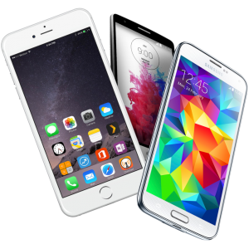
Create A video with your cellphone

Slide 2

Step one:
Download and Read Manual!!!

Slide 3

Step two:
Play, try it out, have fun!

Slide 4
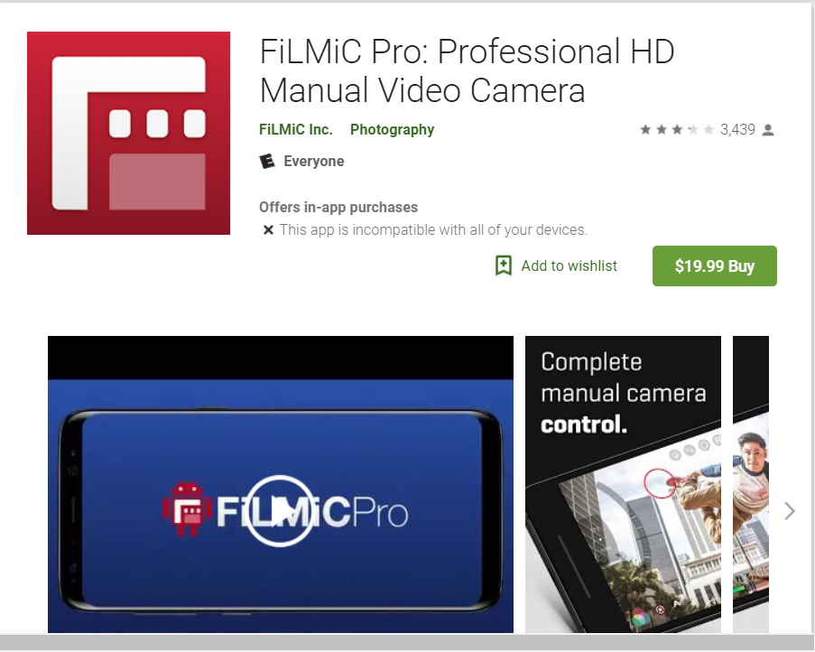
https://www.filmicpro.com/

Slide 5
All things to consider Cellphone-wise

Slide 6
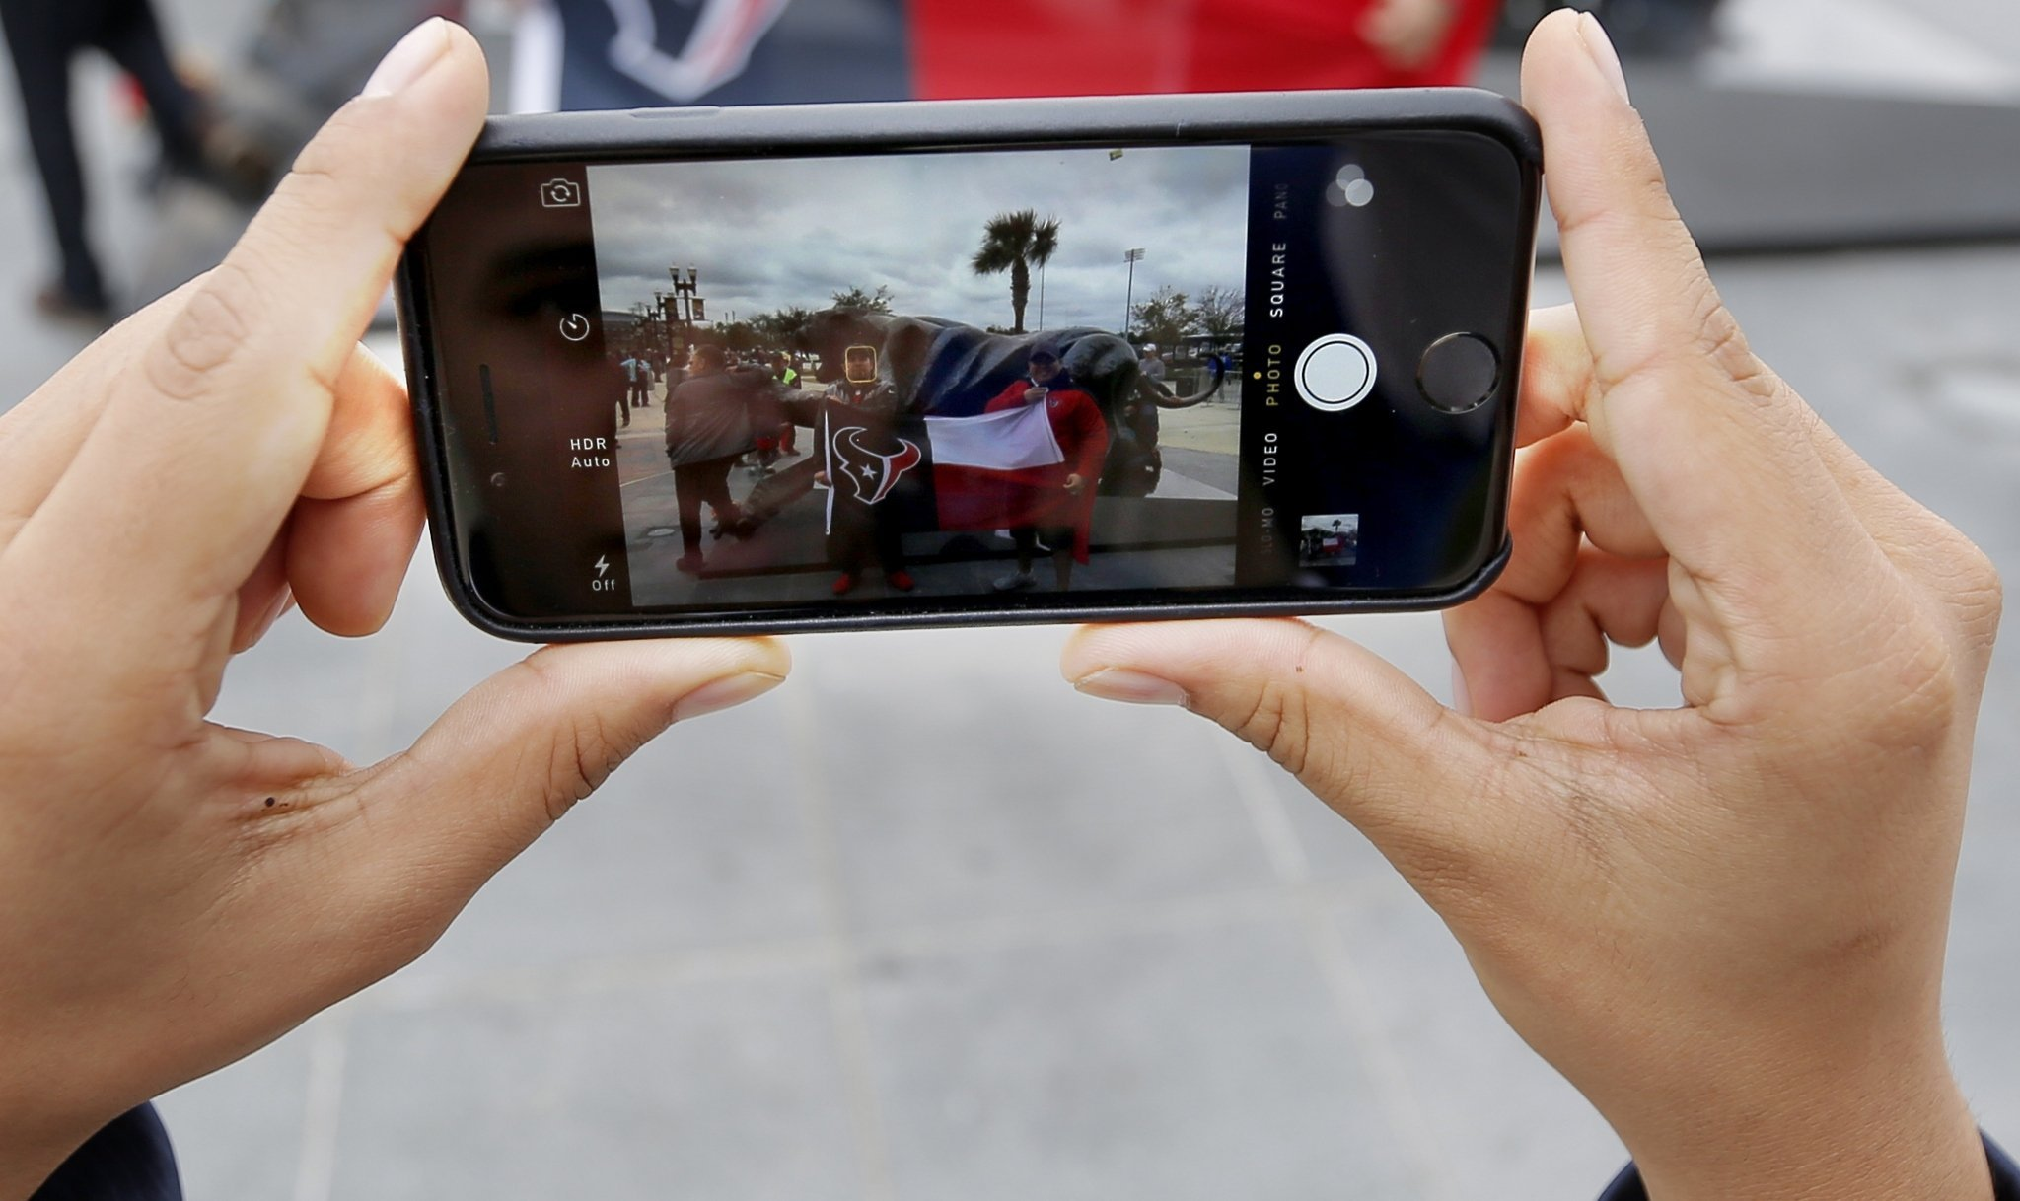
CONSIDER ALWAYS
HOLDING THE PHONE
SIDEWAYS

Slide 7
Camera / Phone Settings..
And why!!!
Automatic
Picture Size
White Balance
Aperture
Shutter Speed
Focus

Slide 8
Camera / Phone Other..
Concerns and why
Recording Room
Battery Power
Airplane Mode
Alerts and Alarms

Slide 9
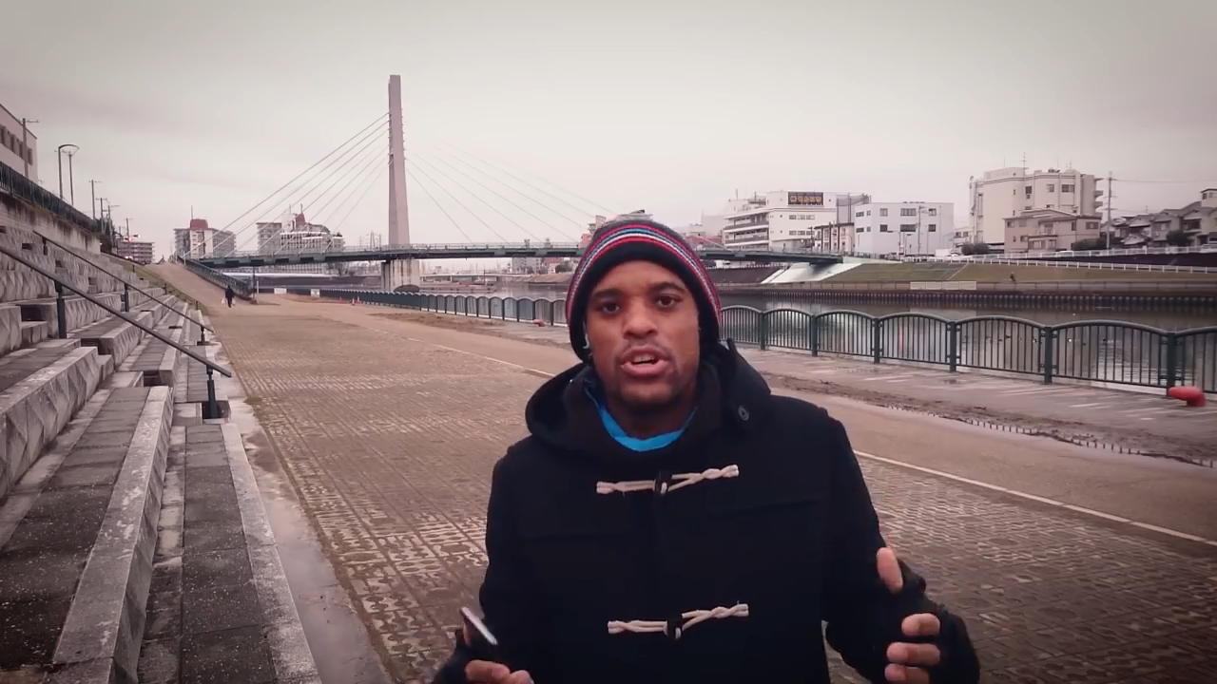
Moves! you are the tripod!

Slide 10
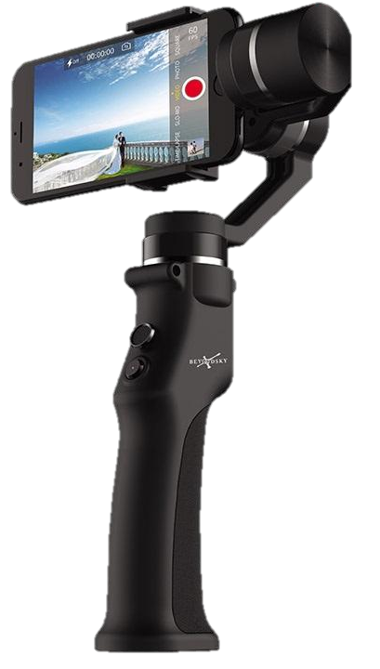

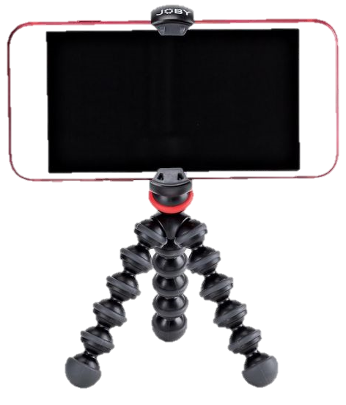
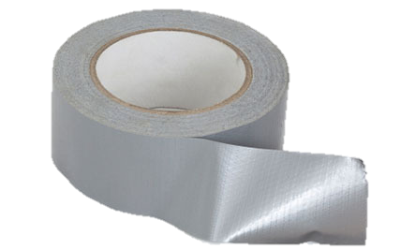
Camera / Phone..
Holding on to it
Hands
Tripod
Pile of books,
Duct Tape
Exotic things

Slide 11
Shooting Do(s)
Shoot with strongest light on your subject.
Do shoot with the sun / light behind the camera and shining on the subject.
Do make sure that your shadow does not fall into the picture
Do have the Phone close to the subject and shoot “zoomed out”
Do have the camera lens at the subjects’ eye level
Do keep an eye on what is being shot.
Do try to make your shots look as much like regular TV as possible.

Slide 12
And some Don’ts
Don’t shoot the person with their back to a wall.
Don’t shoot the person where the background has anything that reflects more light than their face.
Don’t shoot from across the room.

Slide 13
Work Arounds!!!
Shooting against the light – get closer / zoom.
Handheld too shaky – get closer
If you can’t see it while recording it…. And
watch for what you can’t see!

Slide 14
SOUND – The Real
challenge
Murphy’s Law…. If it is there it will be heard
The closer the better
Consider – narration afterwards.
$$$$$ buy a microphone – the half solution.

Slide 15
LOCATION, location,
lOCATION
SAFETY first.
SOUND second
LIGHT third
DISTRACTION fourth
ORGANIZATION fifth… maybe 1st

Slide 16
Video Editing Programs
Win 10 Movie Maker (Windows no longer comes with)
iMovie Mac (Version for iPhone.)
AND a cast of hundreds!
All are “Free” software.
All take a little / lot of Learning.
All should output Mp4

Slide 17

Video Editing Programs - Other

Slide 18
Questions?

